Slide 1
DiLA
Digital Learning Agreement
Viadrina International Affairs

Slide 2
Dear students,
Before you start with the Learning Agreement, please think about the courses you would like to take at the partner university. In other words, research specifically which courses you can take there as an incoming student and to what extent they fit in with your curriculum at the Viadrina. In which modules can you have the courses credited? If you are unsure about this, please contact:
WiWi: Torsten Glase (outgoing-wiwi@europa-uni.de)
KuWi BA: Nicole Klück (outgoing@europa-uni.de)
Law: Katja Herzel (outgoing@europa-uni.de)
CuSO: Nicole Richter (buero-nrichter@europa-uni.de)
MES: (geiger@europa-uni.de)
MoDE: Björn Plötner (study-ens@europa-uni.de)
MASS: Stephan Lanz (lanz@europa-uni.de)
All other KuWi MA-Programmes: the responsible MA-Programme Coordinator

Slide 3
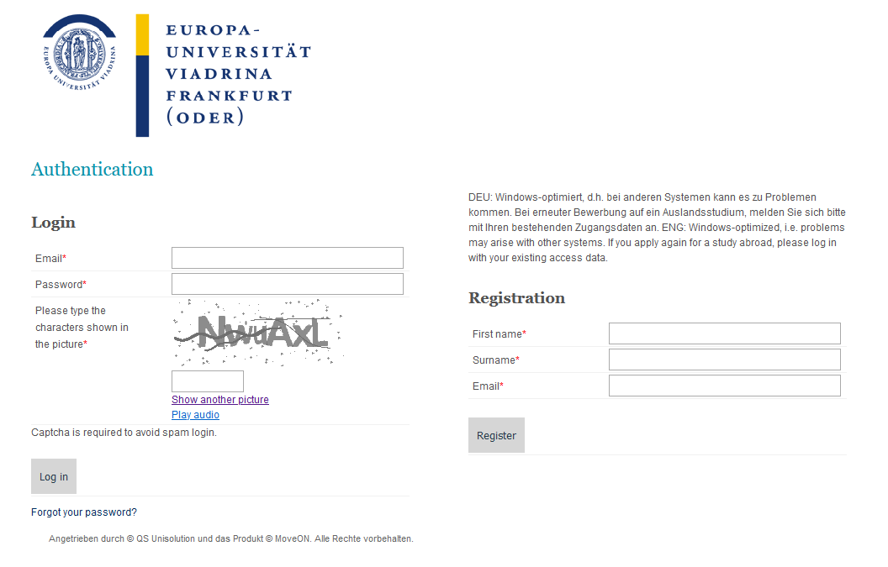
Login MoveOn
You can create your DiLA on the following website by registering as usual on the application portal MoveOn
https://europauni.moveon4.de/locallogin/650d48f8a6c53154460d5ef5/eng

Slide 4
Start page from MoveOn
You can initiate a DiLA under Learning Agreements
To initiate a DiLa, please select Mobility Type
  Example: for exchange Semester select “semester”

Slide 5
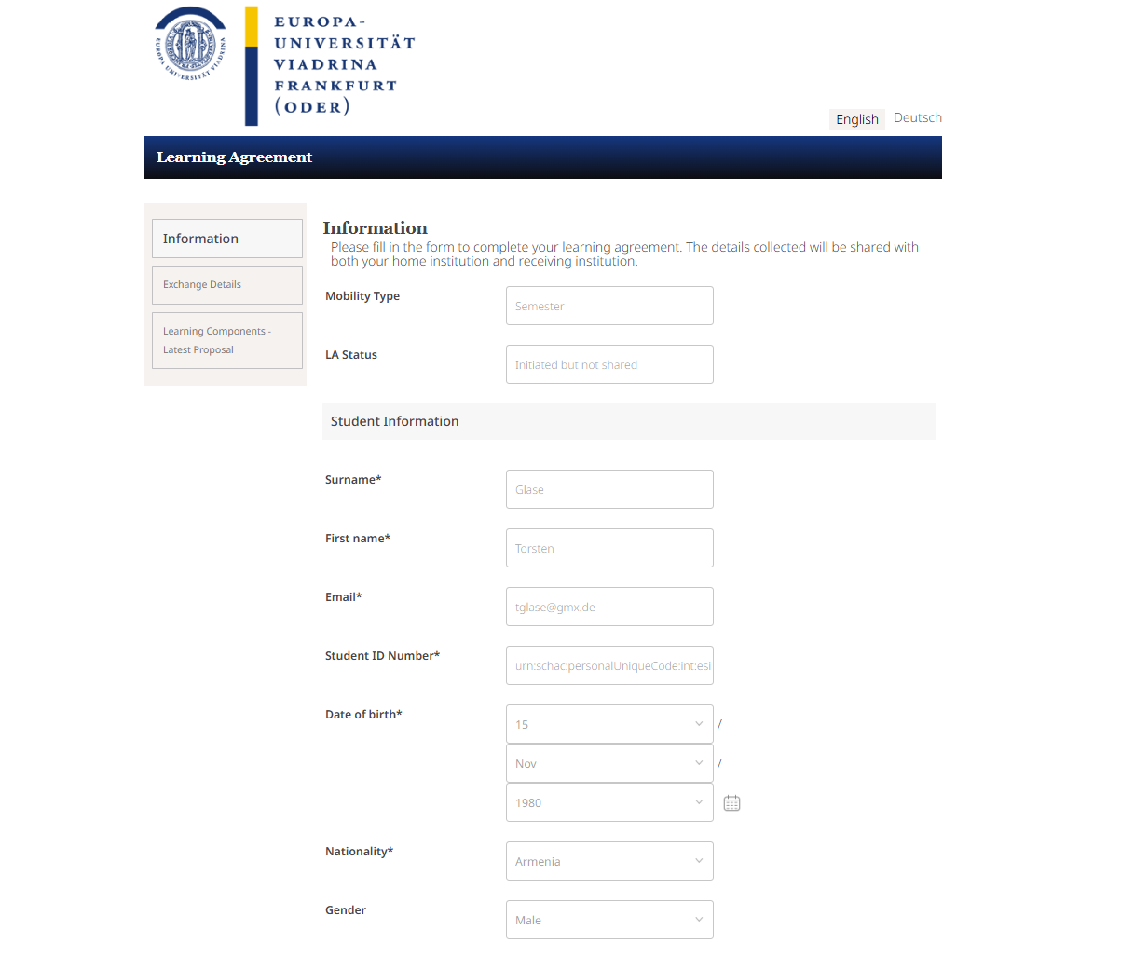
Page 1: Information
Please enter your contact information and your matriculation number in the fields, if not already prefilled

Slide 6
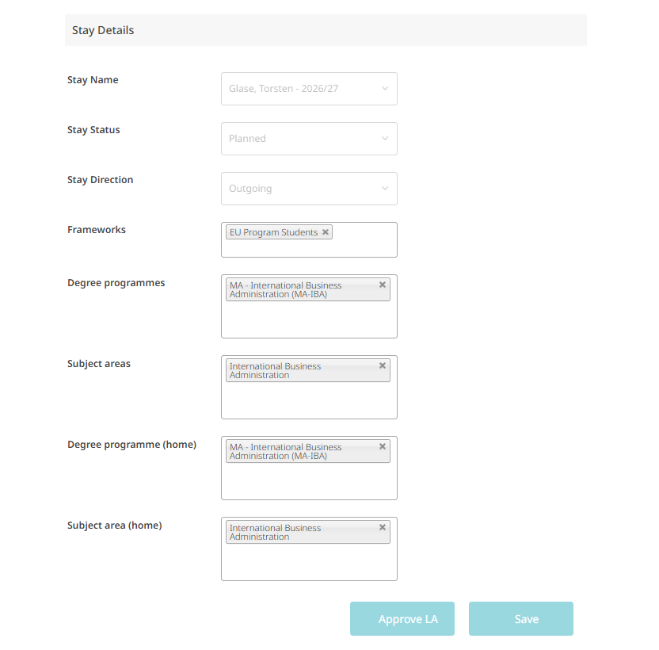
Page 1: Information
For “Frameworks” select “EU Programme Students” for one semester,
for Double Degree Students please select “double Degree Program”
Under “Degree Programme (home)” please select your degree programme

Slide 7
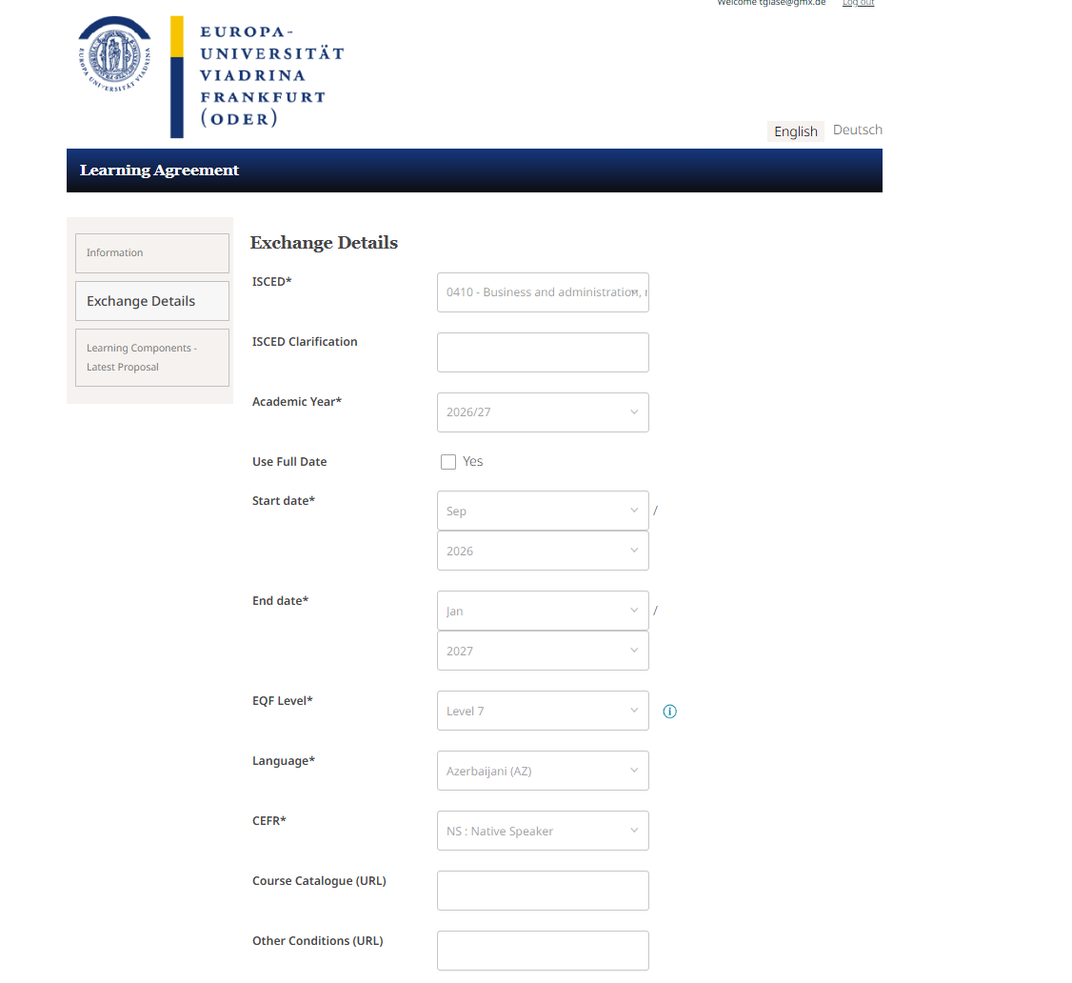
Page 2: Exchange Details
All fields marked with an star must be completed
Enter information about
  Duration of your stay
  EQF Level: BA=6; MA=7; PhD=8
  Language level according to your certificate
Share the Link to the course Catalogue from your partner university

Slide 8
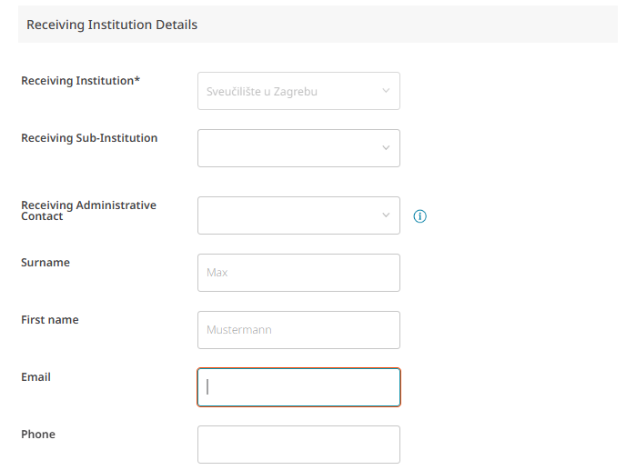
Seite 2: Exchange Details
Please enter the contact details of the partner university here
  You can find your contact person in emails you have received from the partner university or on the partner university's website.
IMPORTANT! Without contact information, the DiLA cannot be forwarded to the partner university

Slide 9
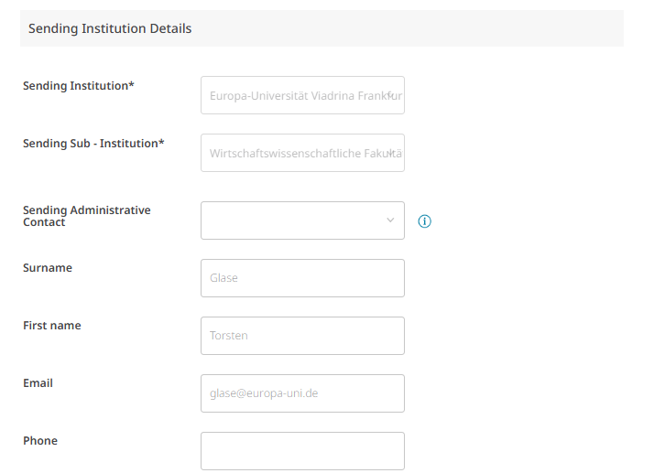
Seite 2: Exchange Details
Please enter the contact information of the person responsible for your study programme at Viadrina (see page 2 and 16)

Slide 10
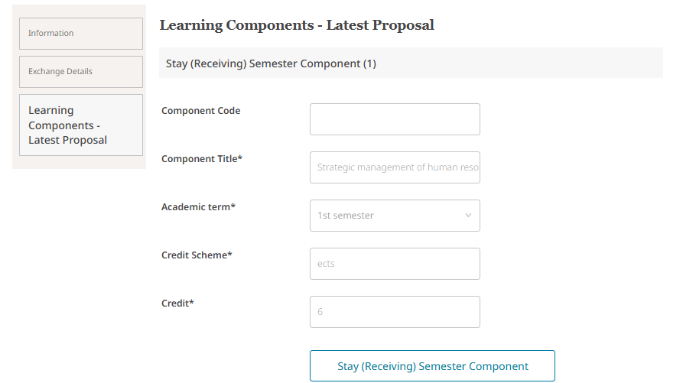
Seite 3: Learning Agreement Components
Firstly, enter the course you would like to take at the partner university
You will need
  Title of the course
  the points system of the partner university
  how many points are allocated to the course in the partner university's system
To add another
Course
click here

Slide 11
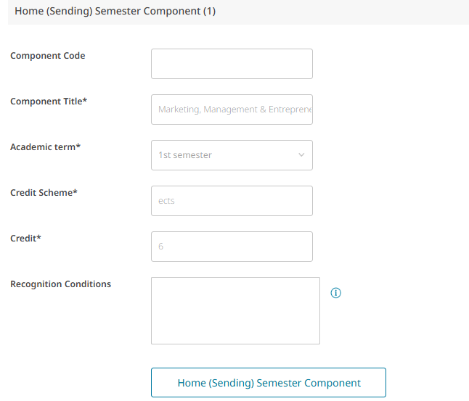
Seite 3: Learning Agreement Components WiWi
Then assign the courses to a module group (not a direct course) of your degree programme at the Viadrina:
  Example IBA Bachelor
    Component Title: Marketing, Management & Entrepreneurship
  Example IBA Master
    Component Title: Marketing & Management
Please click here for information on the conversion of credits:
https://www.europa-uni.de/en/internationalitaet/outgoing/studierende/planung/details-anerkennung/details-anerkennung-faqs/index.html#1-faq-wiwi-155398007
To add another
Course
click here

Slide 12
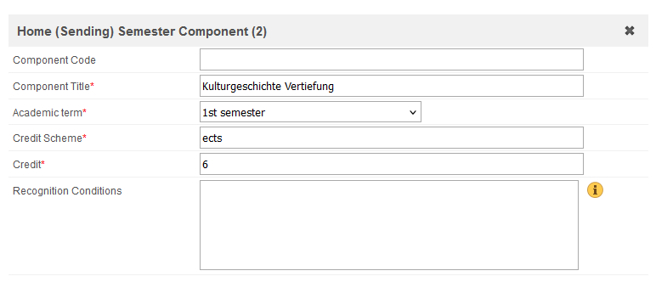
Seite 3: Learning Agreement Components KuWi
Then assign the courses to a module of your degree programme at the Viadrina:
  Example Bachelor
    Component Title: Kulturgeschichte Vertiefung
  Example Master
    Component Title: Regieren in Europa
Please hand in the course discriptions via emial
Please click here for information on the recognition
https://www.europa-uni.de/en/internationalitaet/outgoing/studierende/planung/details-anerkennung/details-anerkennung-faqs/index.html#3-faq-kuwi-ba-155398357

Slide 13
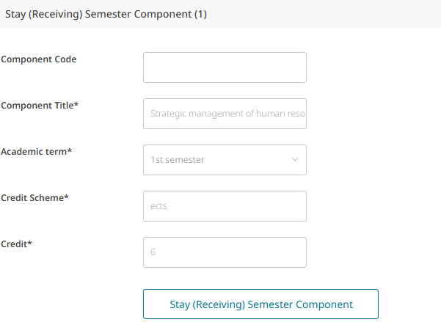
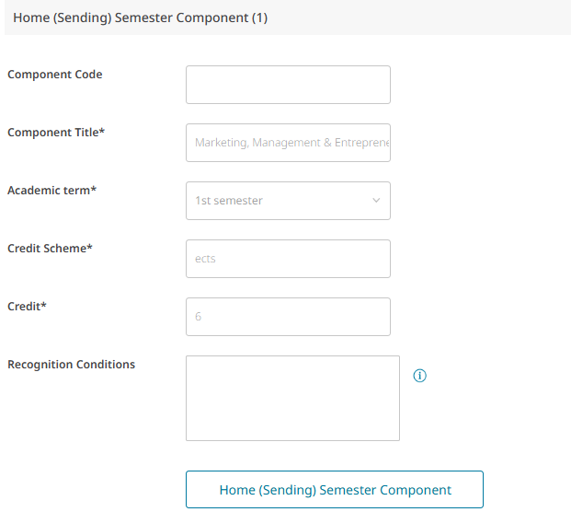
Seite 3: Learning Agreement Components
The “Stay (Receiving) Semester Component (1)” corresponds to the “Home (Sending) Semester Component (1)”
Here you decide which course from abroad (receiving) should be recognized in which module group at Viadrina (sending)

Slide 14


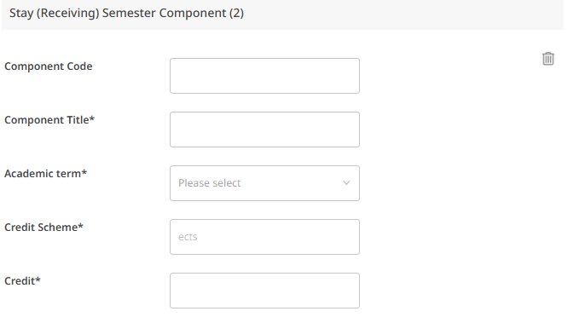
Seite 3: Learning Agreement Components
You can add further components to your Learning Agreement by adding a component to Stay and Home
Remove components from your Learning Agreement

Slide 15
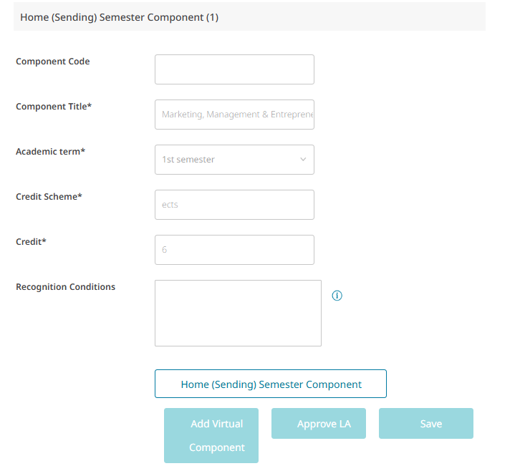
Seite 3: Learning Agreement Components
In the last step, please approve the DiLA, only then will the indicated contact persons be informed and can also approve the DiLa. If any changes are made by the departmental coordinator, you will be notified and will need to approve them again.

Slide 16
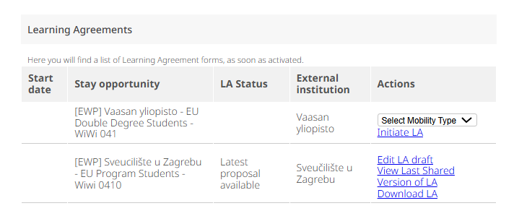
Changes to the DiLA during your stay or if you do an extension of
your stay abroad

Slide 17
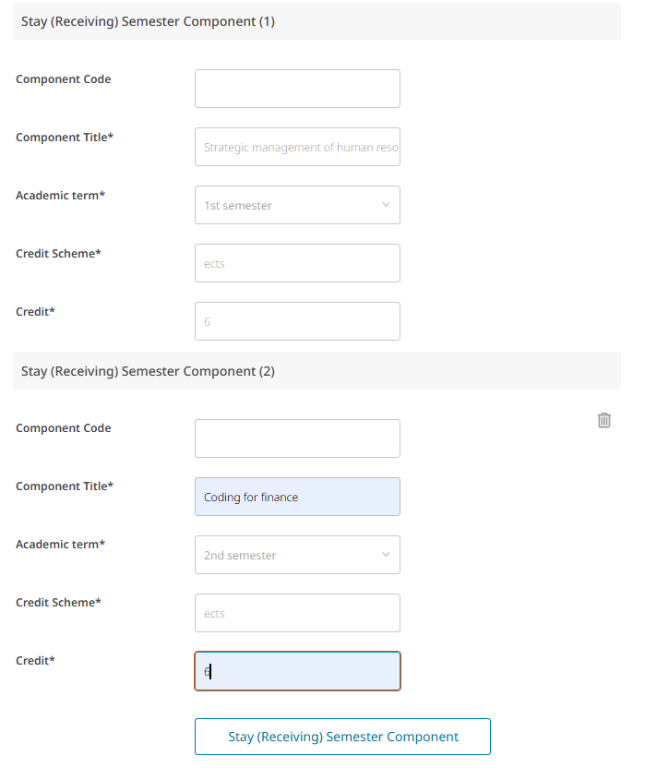
Changes to the DiLA during your stay or if you do an extension of your stay abroad
Here, you can change individual courses or add new ones for the second semester. Make sure to select 2nd semester here.

Slide 18
Your contact persons for recognition
Torsten Glase
all WiWi BA und MA
Wirtschaft und Recht (für Wirtschaft)
Outgoing-wiwi@europa-uni.de
0335 5534 2595
Katja Herzel
Jura, Recht und Politik (für Recht)
Recht und Wirtschaft (für Recht)
Deutsch-Polnisches Jurastudium (BA/MA/mgr)
outgoing@europa-uni.de
0335 5534 2593
Nicole Klück
KuWi BA
Recht und Politik (für Politik)
outgoing@europa-uni.de
0335 5534 2602
Nicole Richter
CuSO
buero-nrichter@europa-uni.de
0335 5534 16 6845
Ruth Geiger
MES
geiger@europa-uni.de
0335 5534 2822
Björn Plötner
ENS
ploetner@europa-uni.de
0335 5534 16 6766
Stephan Lanz
MASS
lanz@europa-uni.de
0335 5534 2384
For all other KuWi-MA-Programmes: the
responsible Programme Coordinator

